Slide 1


01
Introduction to Data Science
02
Data Science Lifecycle
03
Applications of Data Science
04
Introduction to Cloud and Azure Cloud
05
Features of Azure Cloud

Slide 2
What is Data Science?
Data science is the exploration and quantitative analysis of all available structured and unstructured data to develop understanding, extract knowledge, and formulate actionable results.
To Gain Insights into Data through Computation, Statistics and Visualization

Slide 3
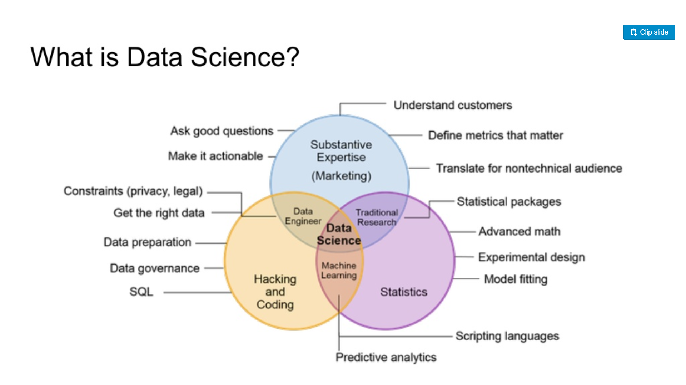

Slide 4
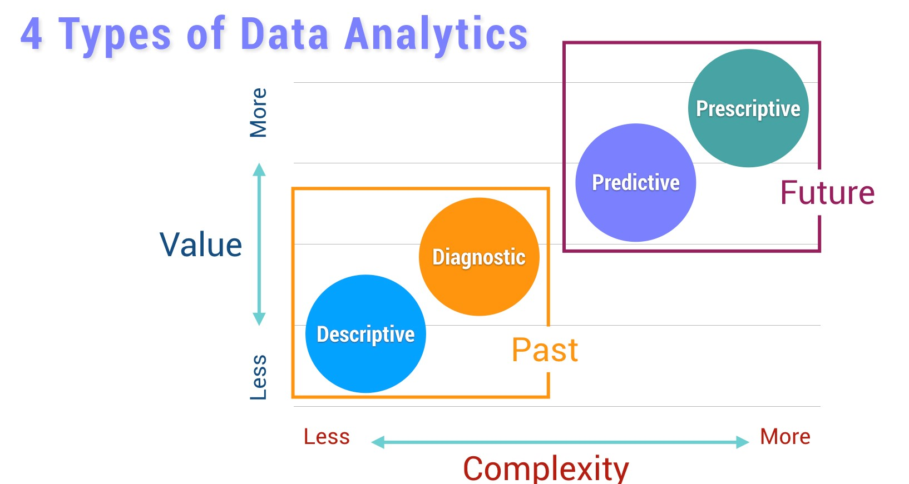

Slide 5
Data Science Life Cycle
CRoss Industry Standard Process for Data Mining (CRISP-DM)
Business Understanding
Data Understanding
Data Preparation
Modeling
Evaluation
Deployment
Identify project objectives
Collect and review data
Select and cleanse data
Manipulate data and draw conclusions
Evaluate model and conclusions
Apply conclusions to business
Notes:
Now, KDD wasn’t the only game in town before the CCC whitepapers. This is CRISP-DM – Cross.... These guys were really serious about formalizing the process. They wrote a 77 page manual on how to do this stuff. I actually like CRISP-DMs process the best, because it includes business understanding and data understanding. I also love all the backwards arrows showing how many iterations you do within this process on a regular basis. Anyway, this is the process I tend to think of.

Slide 6
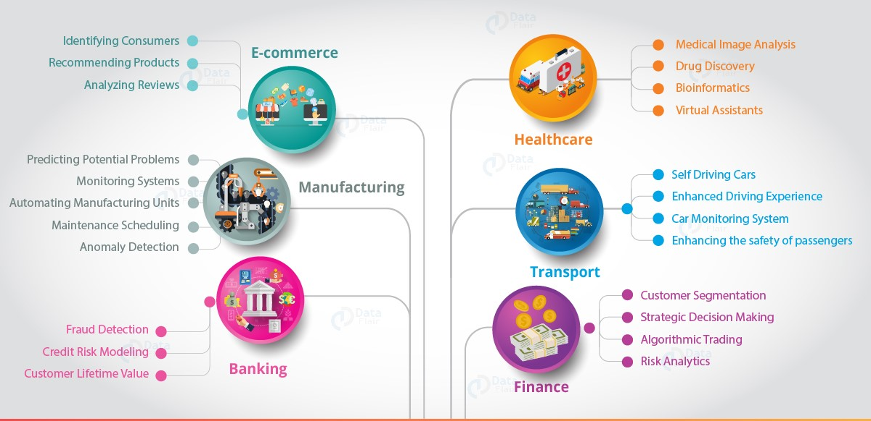
Applications of Data Science
Notes:
Now, KDD wasn’t the only game in town before the CCC whitepapers. This is CRISP-DM – Cross.... These guys were really serious about formalizing the process. They wrote a 77 page manual on how to do this stuff. I actually like CRISP-DMs process the best, because it includes business understanding and data understanding. I also love all the backwards arrows showing how many iterations you do within this process on a regular basis. Anyway, this is the process I tend to think of.

Slide 7
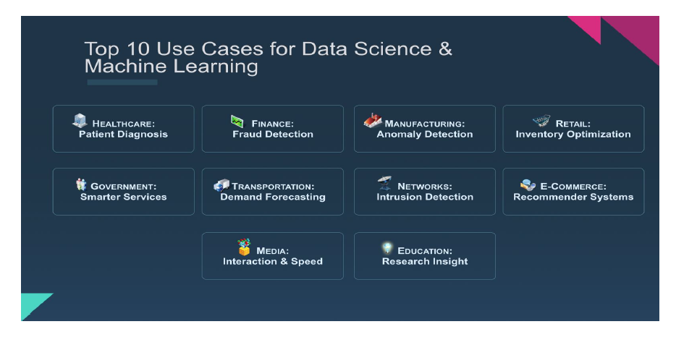
Applications of Data Science
Notes:
Now, KDD wasn’t the only game in town before the CCC whitepapers. This is CRISP-DM – Cross.... These guys were really serious about formalizing the process. They wrote a 77 page manual on how to do this stuff. I actually like CRISP-DMs process the best, because it includes business understanding and data understanding. I also love all the backwards arrows showing how many iterations you do within this process on a regular basis. Anyway, this is the process I tend to think of.

Slide 8
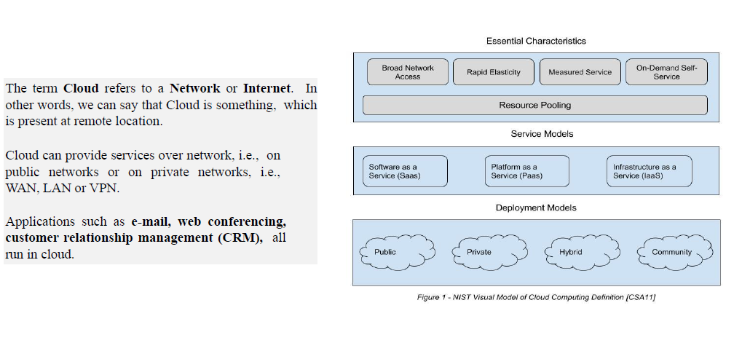
What is Cloud?
Notes:
Now, KDD wasn’t the only game in town before the CCC whitepapers. This is CRISP-DM – Cross.... These guys were really serious about formalizing the process. They wrote a 77 page manual on how to do this stuff. I actually like CRISP-DMs process the best, because it includes business understanding and data understanding. I also love all the backwards arrows showing how many iterations you do within this process on a regular basis. Anyway, this is the process I tend to think of.

Slide 9
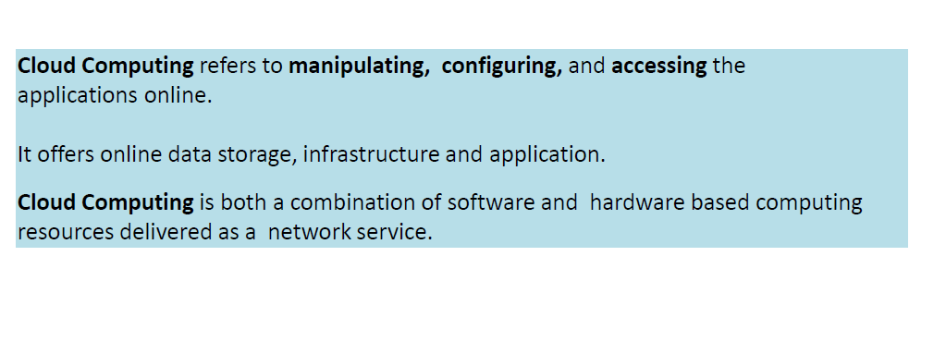
What is Cloud Computing?
Notes:
Now, KDD wasn’t the only game in town before the CCC whitepapers. This is CRISP-DM – Cross.... These guys were really serious about formalizing the process. They wrote a 77 page manual on how to do this stuff. I actually like CRISP-DMs process the best, because it includes business understanding and data understanding. I also love all the backwards arrows showing how many iterations you do within this process on a regular basis. Anyway, this is the process I tend to think of.

Slide 10
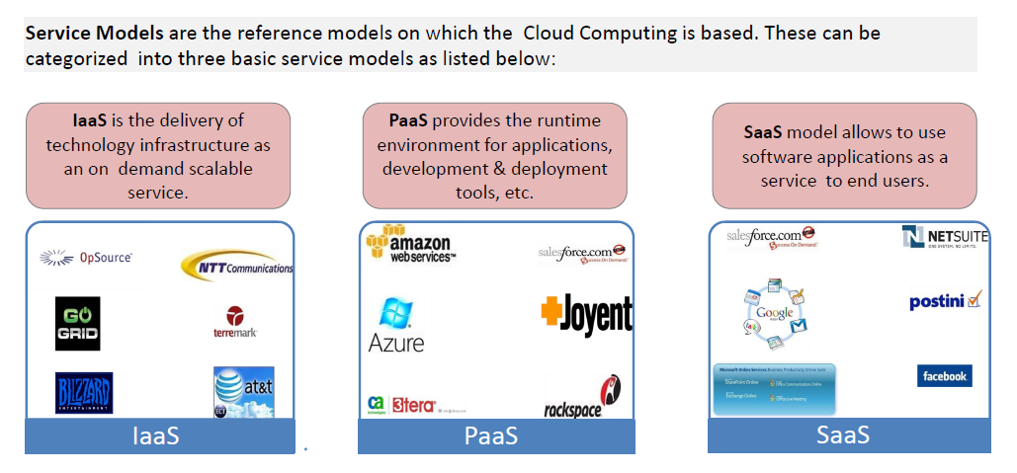
Service Models in Cloud
Notes:
Now, KDD wasn’t the only game in town before the CCC whitepapers. This is CRISP-DM – Cross.... These guys were really serious about formalizing the process. They wrote a 77 page manual on how to do this stuff. I actually like CRISP-DMs process the best, because it includes business understanding and data understanding. I also love all the backwards arrows showing how many iterations you do within this process on a regular basis. Anyway, this is the process I tend to think of.

Slide 11
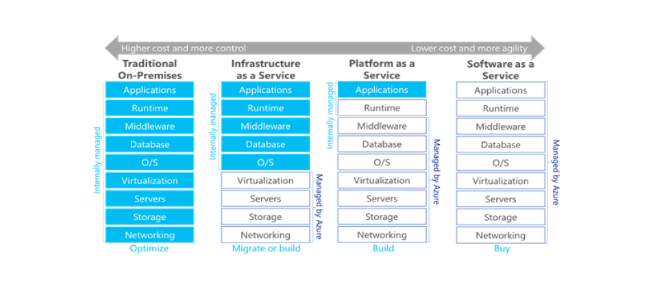
Service Models in Cloud Cont..
Notes:
Now, KDD wasn’t the only game in town before the CCC whitepapers. This is CRISP-DM – Cross.... These guys were really serious about formalizing the process. They wrote a 77 page manual on how to do this stuff. I actually like CRISP-DMs process the best, because it includes business understanding and data understanding. I also love all the backwards arrows showing how many iterations you do within this process on a regular basis. Anyway, this is the process I tend to think of.

Slide 12
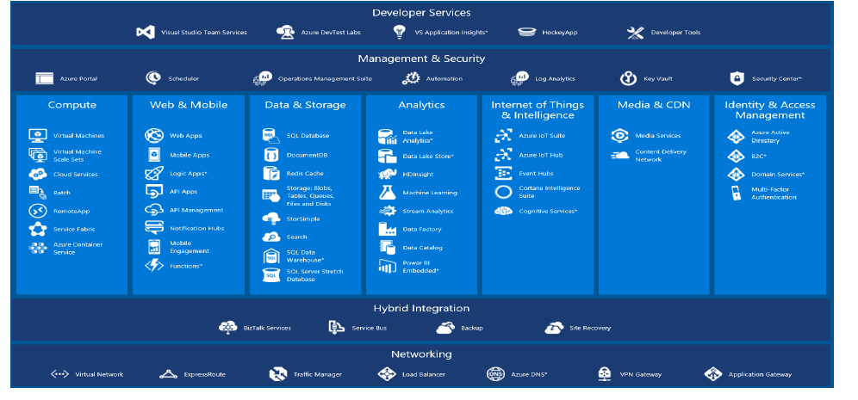
Azure Cloud Services
Notes:
Now, KDD wasn’t the only game in town before the CCC whitepapers. This is CRISP-DM – Cross.... These guys were really serious about formalizing the process. They wrote a 77 page manual on how to do this stuff. I actually like CRISP-DMs process the best, because it includes business understanding and data understanding. I also love all the backwards arrows showing how many iterations you do within this process on a regular basis. Anyway, this is the process I tend to think of.

Slide 13
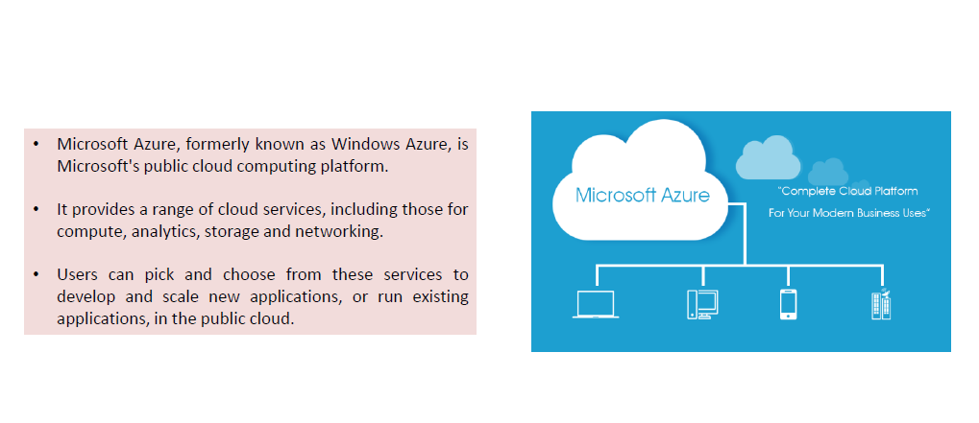
Why Azure?
Notes:
Now, KDD wasn’t the only game in town before the CCC whitepapers. This is CRISP-DM – Cross.... These guys were really serious about formalizing the process. They wrote a 77 page manual on how to do this stuff. I actually like CRISP-DMs process the best, because it includes business understanding and data understanding. I also love all the backwards arrows showing how many iterations you do within this process on a regular basis. Anyway, this is the process I tend to think of.

Slide 14
Why Azure?
Notes:
Now, KDD wasn’t the only game in town before the CCC whitepapers. This is CRISP-DM – Cross.... These guys were really serious about formalizing the process. They wrote a 77 page manual on how to do this stuff. I actually like CRISP-DMs process the best, because it includes business understanding and data understanding. I also love all the backwards arrows showing how many iterations you do within this process on a regular basis. Anyway, this is the process I tend to think of.

Slide 15
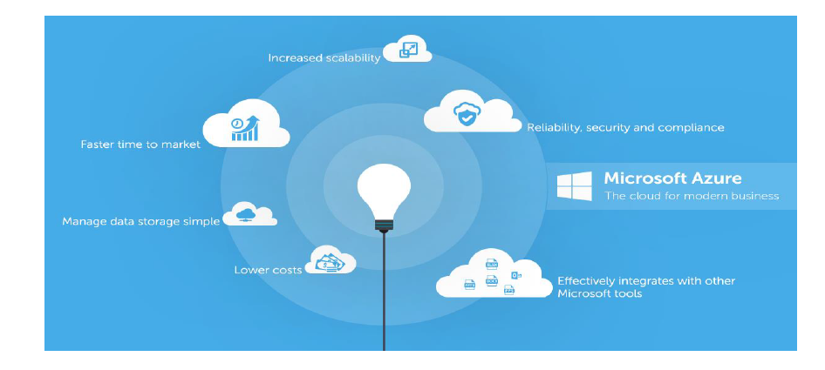
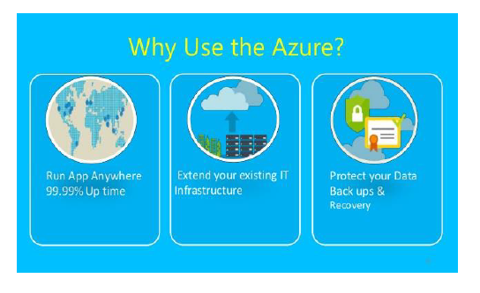
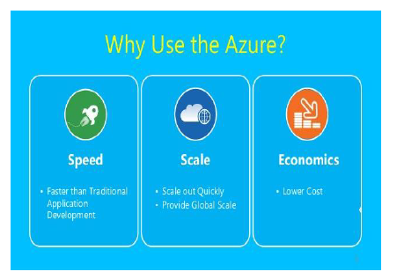
Why Azure?
Notes:
Now, KDD wasn’t the only game in town before the CCC whitepapers. This is CRISP-DM – Cross.... These guys were really serious about formalizing the process. They wrote a 77 page manual on how to do this stuff. I actually like CRISP-DMs process the best, because it includes business understanding and data understanding. I also love all the backwards arrows showing how many iterations you do within this process on a regular basis. Anyway, this is the process I tend to think of.

Slide 16
Thank you
Visit us at www.techmahindra.com

